Slide 1
Uva 10891
Game of Sum
Time: 3 seconds

Slide 2
Problem Description (1/2)
This is a two player game. Initially there are n integer numbers in an array and players A and B get chance to take them alternatively.
Each player can take one or more numbers from the left or right end of the array but cannot take from both ends at a time. He can take as many consecutive numbers as he wants during his time. The game ends when all numbers are taken from the array by the players.

Slide 3
Problem Description (2/2)
The point of each player is calculated by the summation of the numbers, which he has taken.
Each player tries to achieve more points from other. If both players play optimally and player A starts the game then how much more point can player A get than player B?

Slide 4
Input
The input consists of a number of cases.
Each case starts with a line specifying the integer n (0 < n ≤ 100), the number of elements in the array. After that, n numbers are given for the game.
Input is terminated by a line where n = 0.

Slide 5
Output
For each test case, print a number, which represents the maximum difference that the first player obtained after playing this game optimally.

Slide 6

Sample Input / Output
Number of integers
4
4 -10 -20 7
4
1 2 3 4
0
7
10
A
B
A
B
4
7
-10
-20
A=-6 B=-13 A-B=7
A
B
A
7
4 -10
-20
A=-13 B=-6 A-B=-7

Slide 7
Solution
Let d(i, j) 代表第 i 到 j 的子序列，拿者的sum
d(i, j)= sum(i, j) - min{ d(i+1,j),
d(i+2, j),
…, d(j, j),
d(i, j-1),
d(i, j-2),
…,d(i, i),
0 }
i+1
j
i
j-1
i
i+2
j
i
J-2
j
i
j

Slide 8
Solution
sum(i, j) 可以使用 prefix sum
ans=d(i, j)-{sum(i, j)-d(i, j)}
= 2 ╳ d(i, j) – sum (i, j)

Slide 9
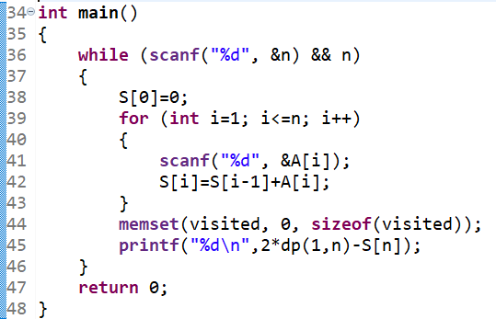
//prefix

Slide 10
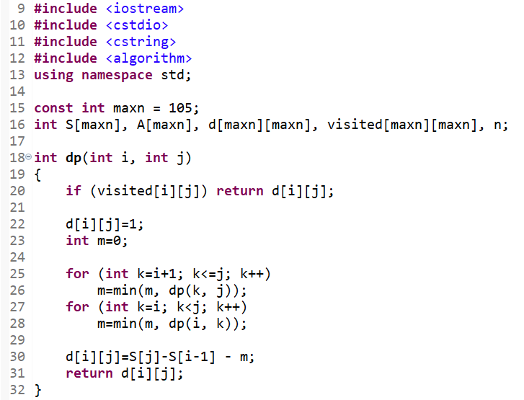
d(i, j)= sum(i, j)
– min{ d(i+1,j),
d(i+2, j),
…, d(j, j),
d(i, j-1),
d(i, j-2),
…,d(i, i),
0 }

Slide 11
Time Complexity
Combination (i, j) → O(n²)
State Transformation of each (i, j)→ O(n)
O(n³)

Slide 12
Solution
Let d(i, j) 代表第 i 到 j 的子序列，拿者的sum
Let f(i, j) =min{ d(i, j), d(i+1, j), d(i+2, j),…,d(j, j) }
Let g(i, j)=min{ d(i, j), d(i, j-1), d(i, j-2),…,d(i, i) }
So
d(i, j)=sum(i, j)-min{ f(i+1, j), g(i, j-1), 0}
f(i, j) =min{ d(i, j), f(i+1, j)}
g(i, j)=min{ d(i, j), g(I, j-1)}

Slide 13
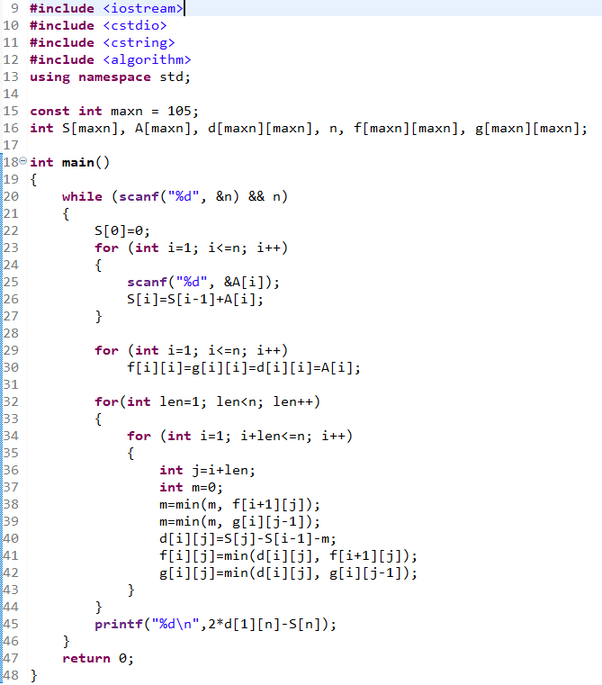
O(n²)
d[i][j]
d[1][n]
f[i][j]
g[i][j]

